Slide 1
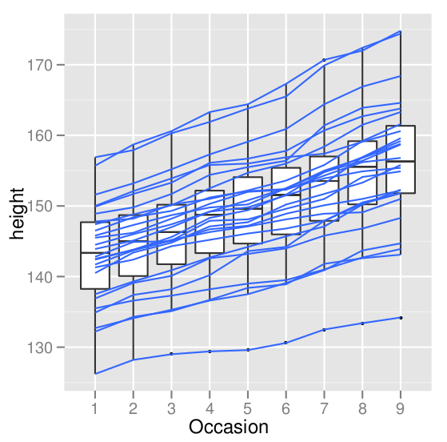
Data visualization and graphic design
Part I: Principles of data visualization
Part II: Advanced graphs with ggplot2
Allan Just and Andrew Rundle
EPIC Short Course
June 23, 2011
Wickham 2008
Notes:
R can be downloaded from http://cran.r-project.org/ and is available free for Windows, Mac OS X, and Linux.

Slide 2
From your feedback:
Quick review
Help with scales – practice using scales
More practice exercises! Export for powerpoint
Bar charts
Working with dates

Slide 3
Building a plot in ggplot2
data to visualize (a data frame)
map variables to aesthetic attributes
geometric objects – what you see (points, bars, etc)
statistical transformations – summarize data
scales map values from data to aesthetic space
faceting subsets the data to show multiple plots
coordinate systems put data on plane of graphic
Wickham 2009

Slide 4
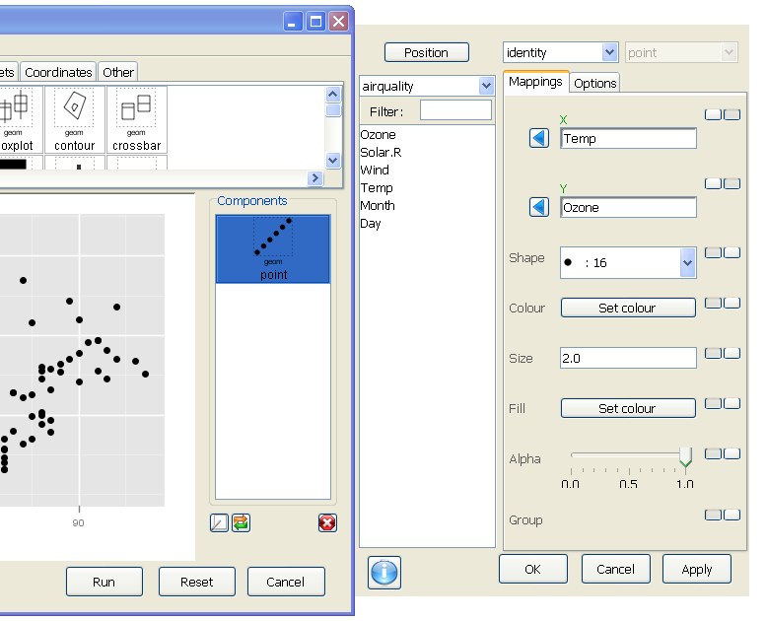
Deducer: mapping versus setting
Column of buttons
switch between states
These two are
being mapped
Remainder are set
(using default settings)

Slide 5
Transforming in scale vs coord stat shown is Bootstrap 95% CI for mean
Rescaled to log
then stat was computed
Stat on raw values
transformed in coord
Perfume use over 48 hours and urinary monoethyl phthalate (ng/ml)

Slide 6
Saving your output
I like to leave space to do my title in powerpoint
To control the size of the output
Use the ggsave() function:
ggsave(file, fig, height = 6.5, width = 10)
defaults to 300 dpi
A default powerpoint slide is 7.5" high
and 10" wide
Save a .ggp file to bring back into plot builder

Slide 7
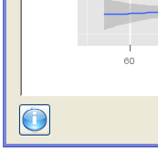
Getting help!
In R:
in the JGR console → Help
?ggsave
In the Plot Builder:
Right-click on any tile in the top portion of the Plot Builder to get option to open the relevant ggplot2 help webpage
Click on button in lower left
for Deducer help page

Slide 8
Longitudinal data: the Oxboys dataset
data(Oxboys) #anthropometrics
str(Oxboys)
Can we make a graph that shows individual height trajectories across visits (occasions)?
How about also overlaying an overall trend smoother?

Slide 9
With your neighbor: Can you use Deducer to remake this plot as a 6.5" high and 6" wide file for a PowerPoint slide?
The line color can be specified as
(R: 51, G: 102, B: 255)
ggplot() +
geom_boxplot(aes(y = height,x = Occasion),data=Oxboys) +
geom_line(aes(x = Occasion,y = height,group = Subject),
data=Oxboys,colour = '#3366ff')
ggsave("Oxboys_redrawn.png", height = 6.5, width = 6)
getwd() #saves to working directory by default

Slide 10
Bar charts
data(mtcars)
str(mtcars) #motor trend cars dataset
By default – ggplot2 expects to compute the summary going in to your bar chart. If you already have tabulated this – you need to switch to stat = "identity"
Let's make a bar chart of counts of cyl:
Oops, cyl is continuous,
let's right-click in the x field and manually map x to: as.factor(cyl)
But isn't this just a histogram?
Let's map the aesthetic fill to vs (it will do so as a factor)
Remember position? – defaulted to position_stack,
let's try position_dodge

Slide 11
Bar charts – the bad kind
data(airquality)
# open the plot builder and add geom_bar
By default – ggplot2 expects to compute a summary for use with geom_bar.
What is the default statistic used with geom_bar()?
If you already have tabulated your summary you would need to switch to stat = "identity" to map to a precomputed y value.
Let's say we wanted to only show the mean…

Slide 12
Working with dates / time series
Bring in dates to R:
str(as.Date("2011-06-23"))
# also see ?strptime
data(economics)
head(economics)
economics.mt <- melt(economics, id.vars = "date")
head(economics.mt)
Now we are going to plot:
Use economics.mt as our data,
use lines, x = date, y = value,
Handy function from Hadley Wickham's
reshape package

Slide 13
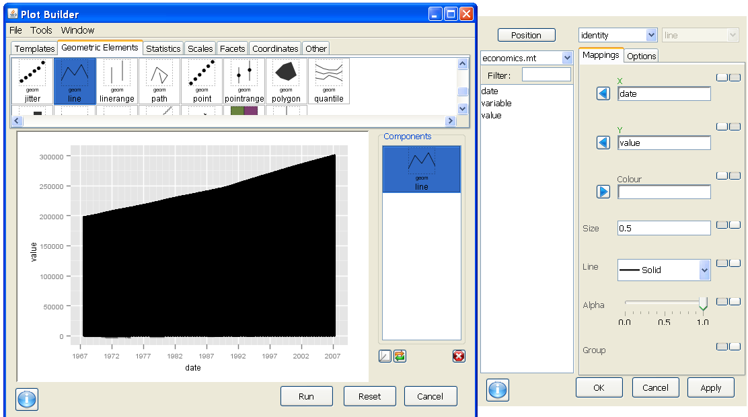
When we plot the new melted data frame with lines we get this – why?

Slide 14
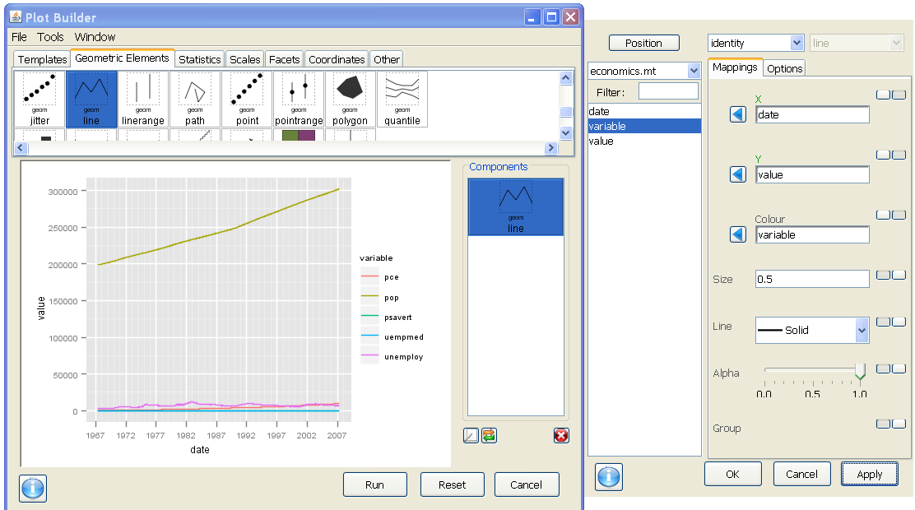
By default, R will group by discrete aesthetics like color
But our data can't really be shown on the same axis – what to do?

Slide 15
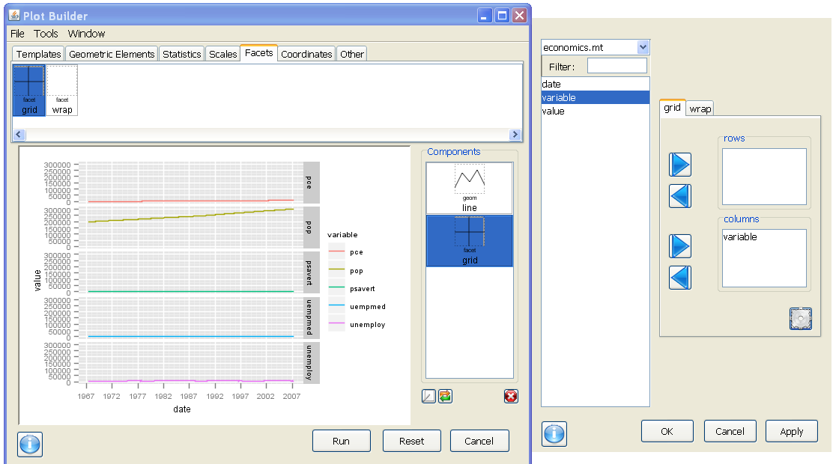
After we facet on rows (in the column box)
we can open the widget for more options

Slide 16
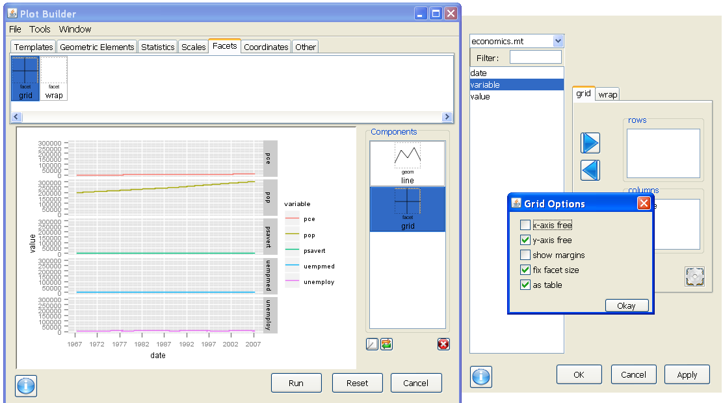
Then I checked off y-axis free ; corresponds to scale = "free_y"

Slide 17
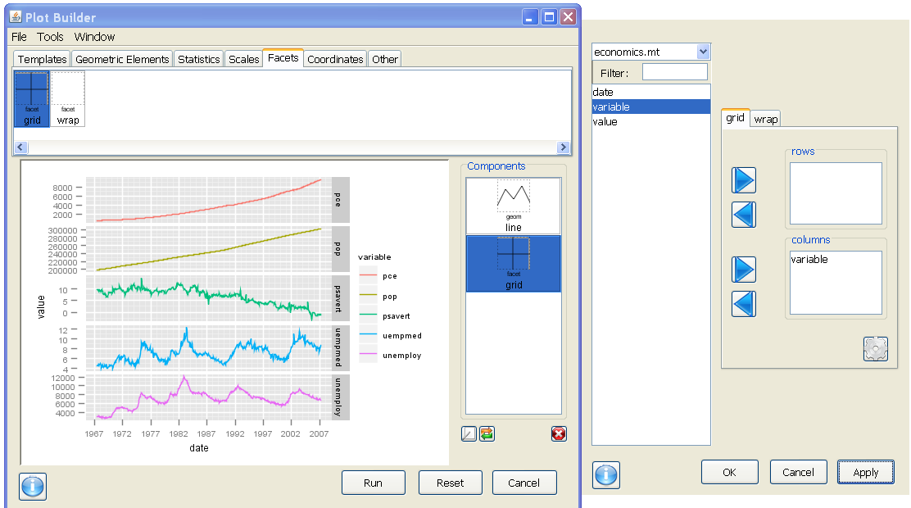
Sweet – stacked time series data on US economic health
But the legend is redundant with the facet labels…

Slide 18
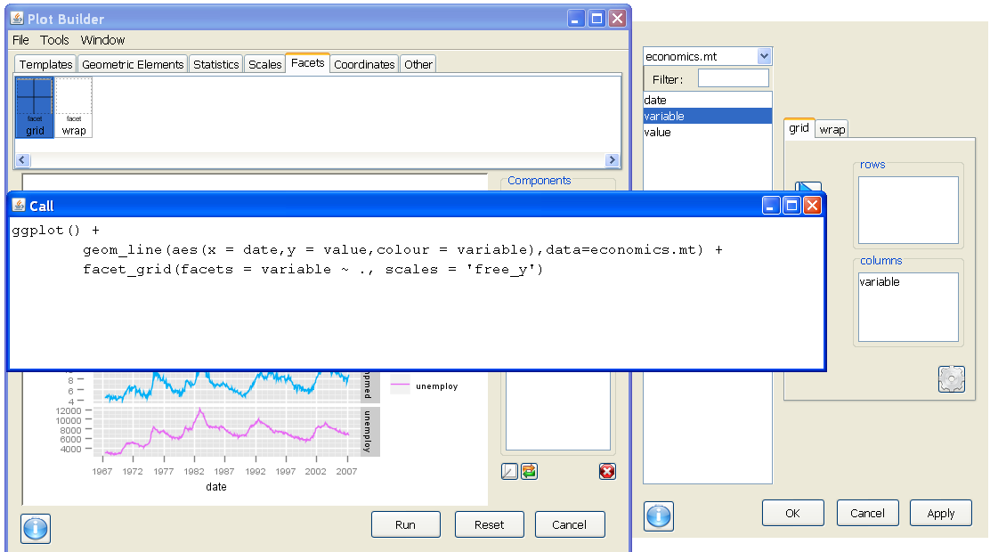
Here is my call. I can't do it in Deducer but in R code, I can turn off a legend, by setting legend=FALSE in the corresponding scale…

Slide 19
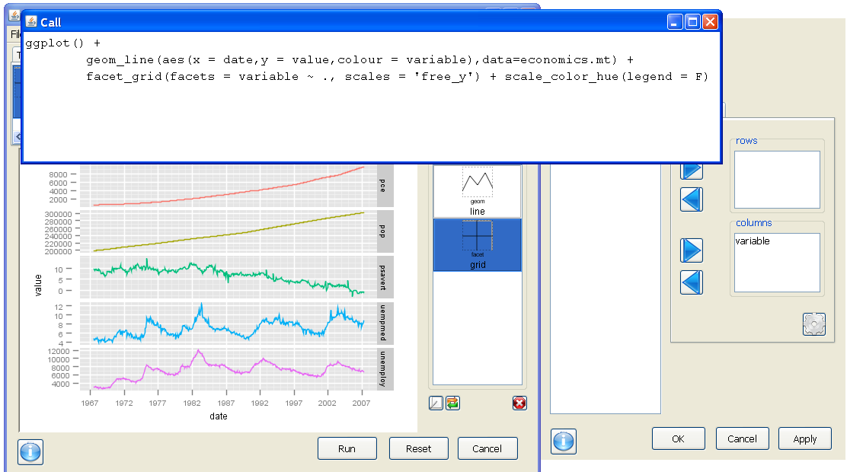
By adding, scale_color_hue(legend = F), we remove the color legend

Slide 20
Polishing your plots
Detailed options for "the look" of a plot
We already covered theme_bw(base_size = 12)
The best source online for custom options:
http://github.com/hadley/ggplot2/wiki/+opts()-List
This was in your handout and emailed on Tuesday

Slide 21
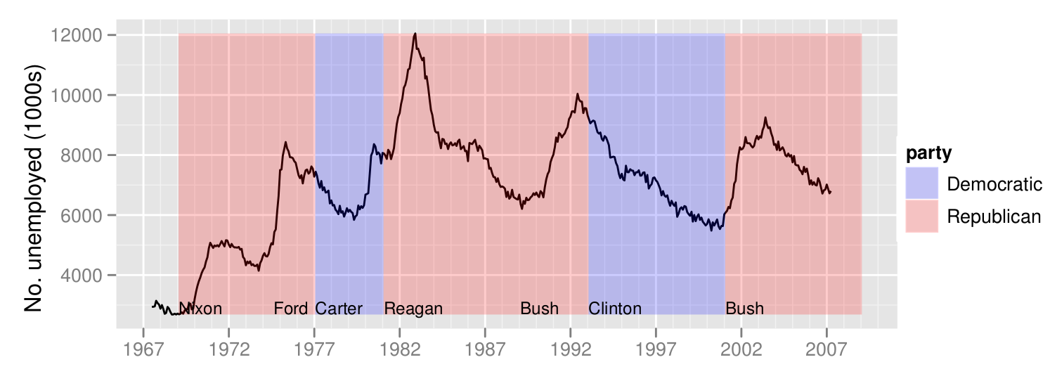
In the ggplot2 book, Hadley extracts just the unemployment data.
He adds presidential party using geom_rect()and labels the
start of each term using geom_text()

Slide 22
Part I: Principles of data visualization
Objectives
Why should you use a particular type of graph?
Graphs versus tables
How can theories of visual perception help you improve your graphs?

Slide 23
Why make a graph?
Communication
Tell the story of your data
Discovery
Your data might not show what you expected

Slide 24

If you paid for the top floor....
www.flickr.com/photos/sincretic/803004418/

Slide 25

Enjoy the view....
www.flickr.com/photos/zachvs/981254718/

Slide 26
John Tukey
The greatest value of a picture is when it forces us to notice what we never expected to see.
— John W. Tukey
Exploratory Data Analysis. 1977

Slide 27
Why should you use a particular type of graph?

Slide 28
What is your question?
Hint: usually this will be a comparison

Slide 29
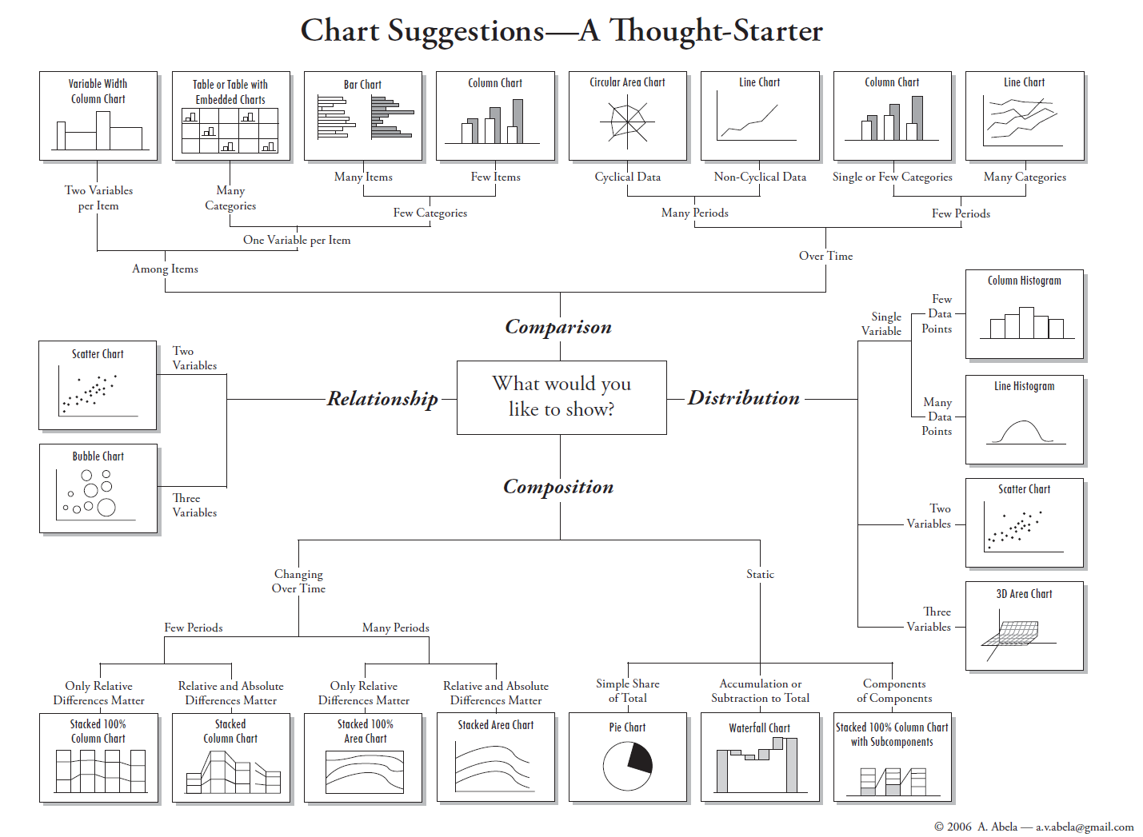

Slide 30
Selecting a type of plot
Replication of standard forms
Outcome
Predictor

Slide 31
Graphs versus Tables
"[getting information from a table] is like extracting sunbeams from cucumbers.”
Farquhar and Farquhar. Economic and industrial delusions. 1891

Slide 32
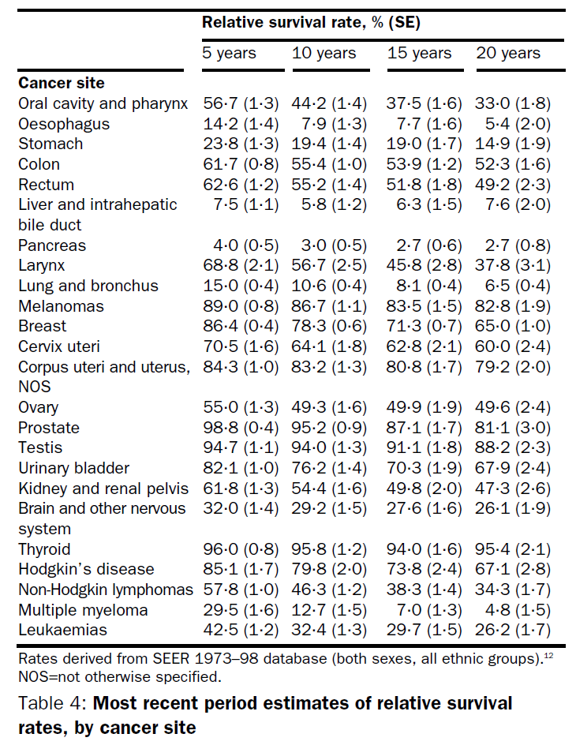
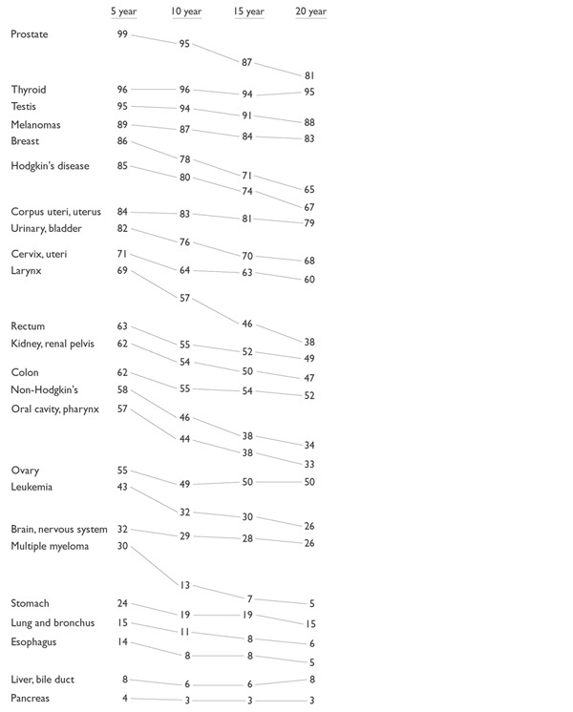
Semi-graphic display
Brenner et al. The Lancet, 2002
edwardtufte.com

Slide 33
How can theories of visual perception help you improve your graphs?

Slide 34
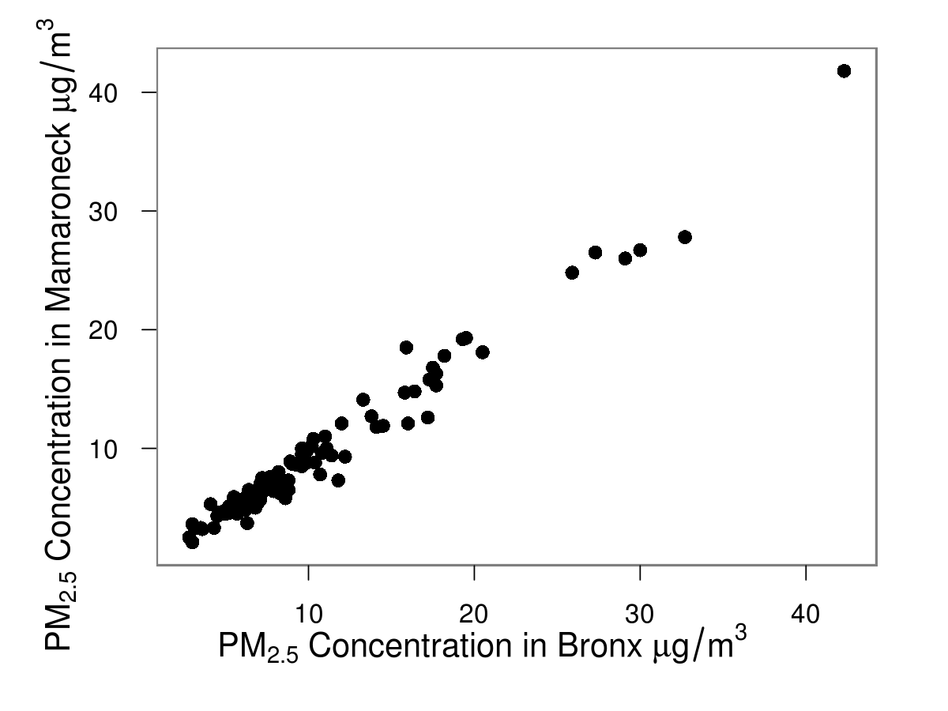
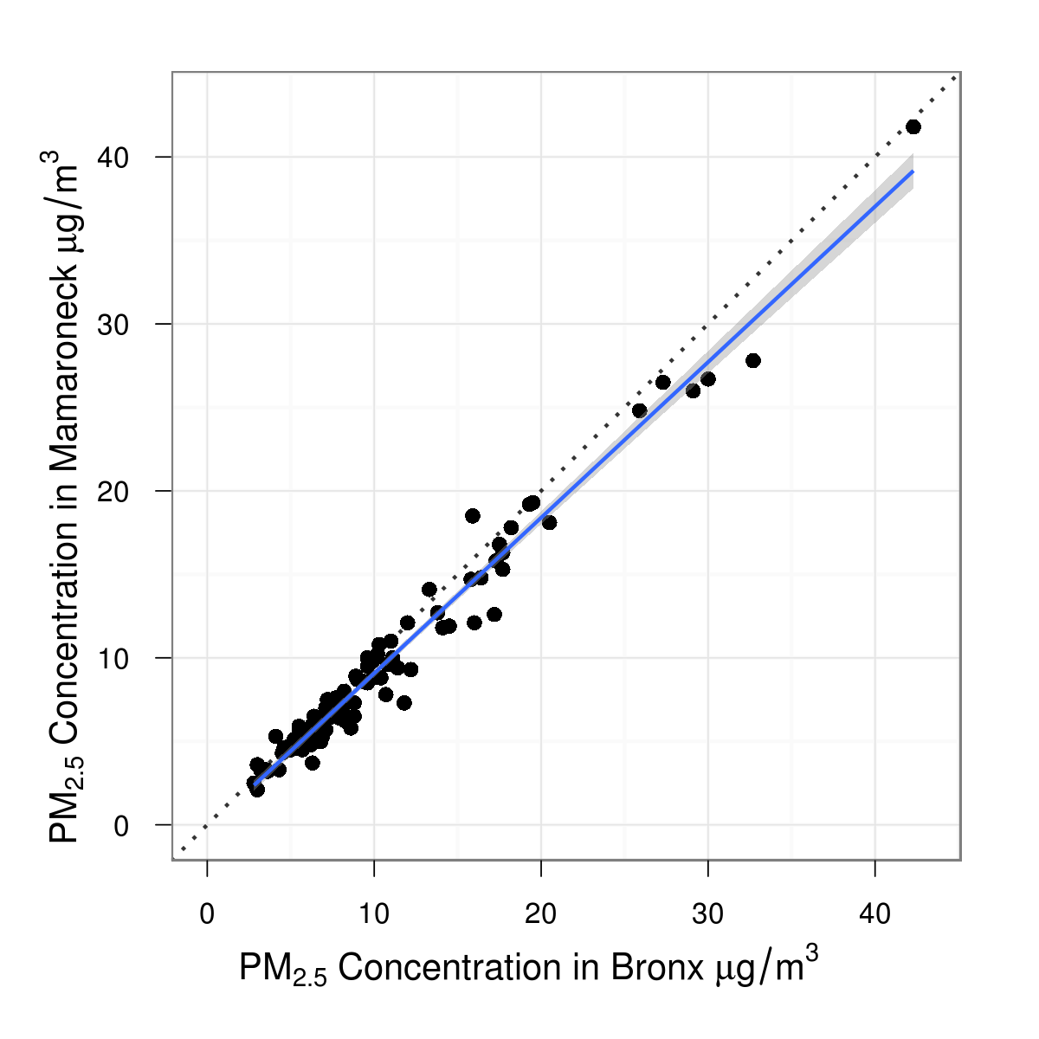
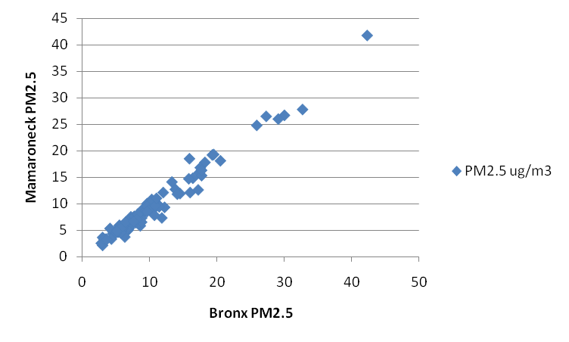
How do you compare two measures?
100 samples of PM_{2.5} from two locations
A square plot creates an expectation of
comparison of equivalent measures

Slide 35
Let's make a square plot!
data(mpg)
str(mpg)
How can we show whether city and highway mileage are comparable for these cars?

Slide 36
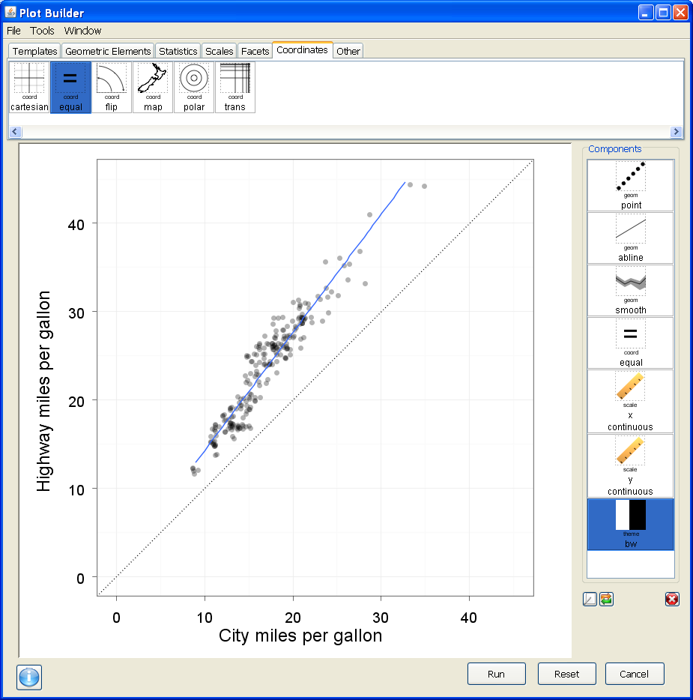
Challenge: can you recreate this plot in Deducer?

Slide 37
Some big hints…
ggplot() +
geom_point(aes(x = cty,y = hwy), data=mpg,
alpha = 0.3, position = position_jitter()) +
geom_abline(data=mpg, slope = 1.0, linetype = 3) +
geom_smooth(aes(x = cty, y = hwy), data=mpg,
method = 'lm', se = FALSE) +
coord_equal() +
scale_x_continuous(name = 'City miles per gallon',
limits = c(0,45)) +
scale_y_continuous(name = 'Highway miles per gallon',
limits = c(0,45)) +
theme_bw(base_size = 24.0)

Slide 38
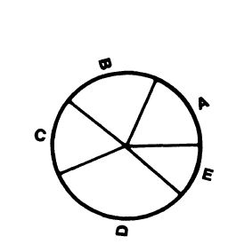
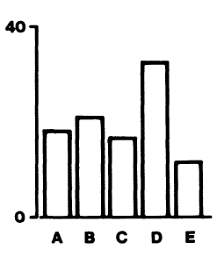
Cleveland’s hierarchy of perceptual scales
Position along a common scale
Position along nonaligned scales
Length; Direction; Angle
Area
Volume; Curvature
Shading; Color saturation
is A larger than B?
Angle
Area
Arc length
Position
Length
Area
Cleveland and McGill. JASA 1984
.

Slide 39
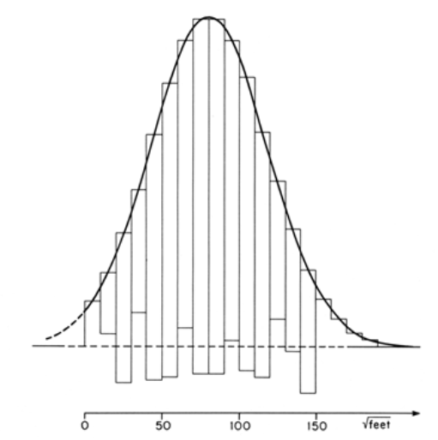
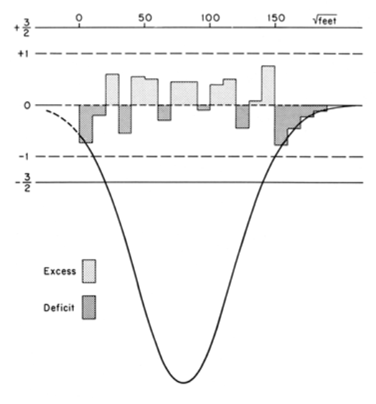
Switching to using position as our scale Tukey's hanging rootogram
Tukey, J. Statistical Papers in Honor of George W. Snedecor. T.A. Bancroft, ed. 1972
Notes:
We all know what a bell curve looks like …
Harder to perceive differences between curves than straight lines
Tukey pins the bin to the curve and has you look at the base

Slide 40
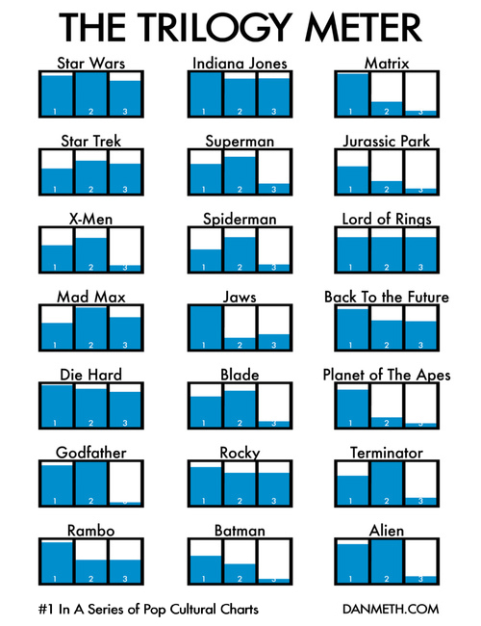
It’s all about your reference:
The black outlines provide a reference to measure length/position of the blue bars or the white negative space
Application of Weber's law (1860):
probability of human detecting difference between two lines related to ratio of the two line lengths

Slide 41
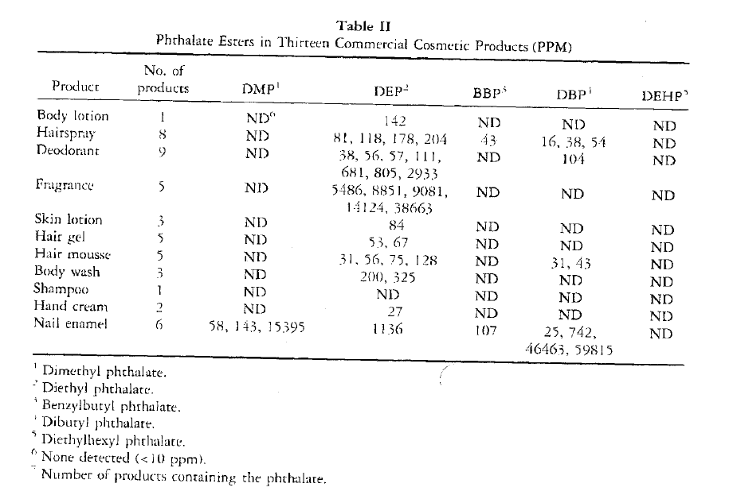
What is the story of this table?
Hubinger and Havery. J Cosmetic Sci. 2006

Slide 42
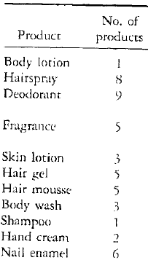
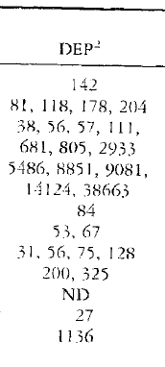
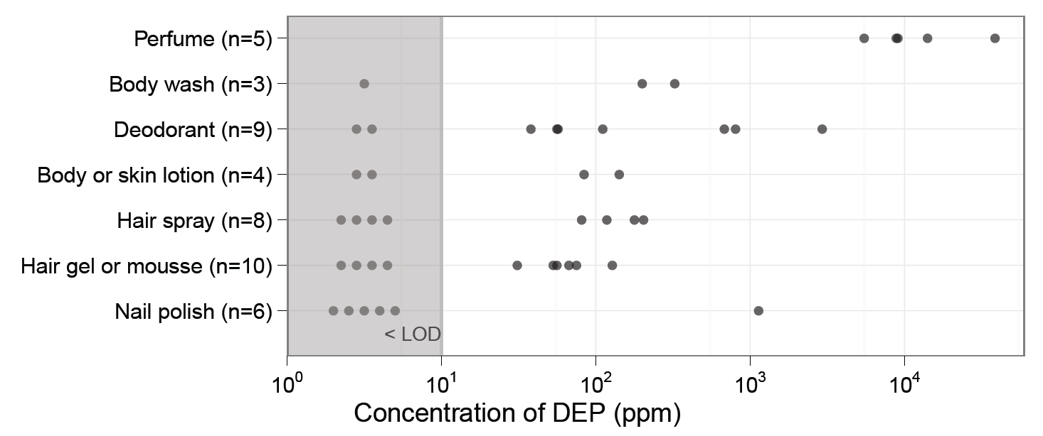
Cleveland’s Dotplot
horizontal labels
reordered categories
use position to show <LOD
Hubinger and Havery. J Cosmetic Sci. 2006
Just et al. JESEE 2010

Slide 43
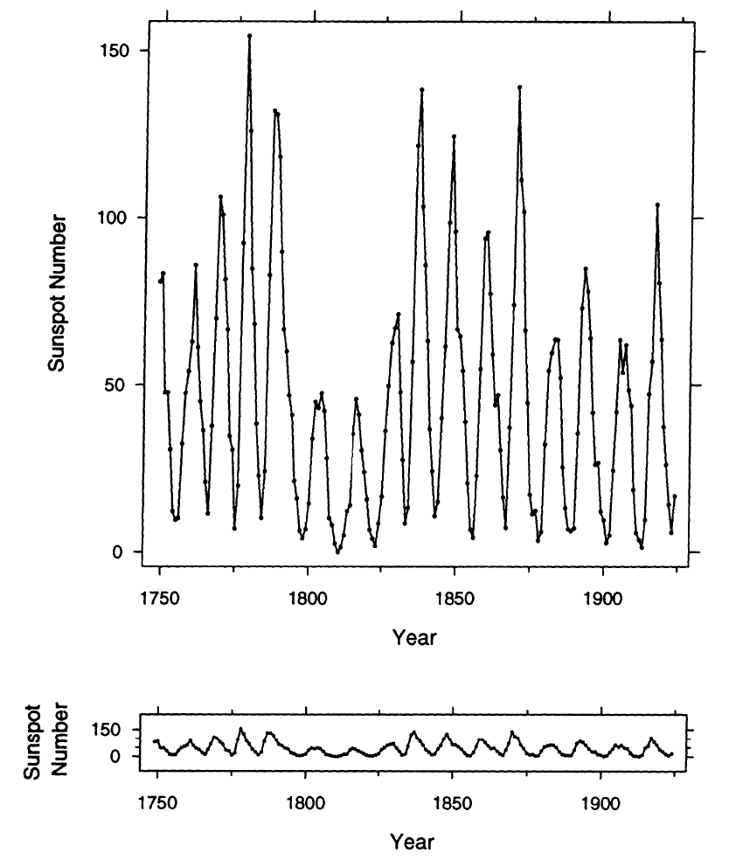
Perception of angles: best at variation from 45˚
Cleveland. J Comp Graph Stats. 1993.

Slide 44
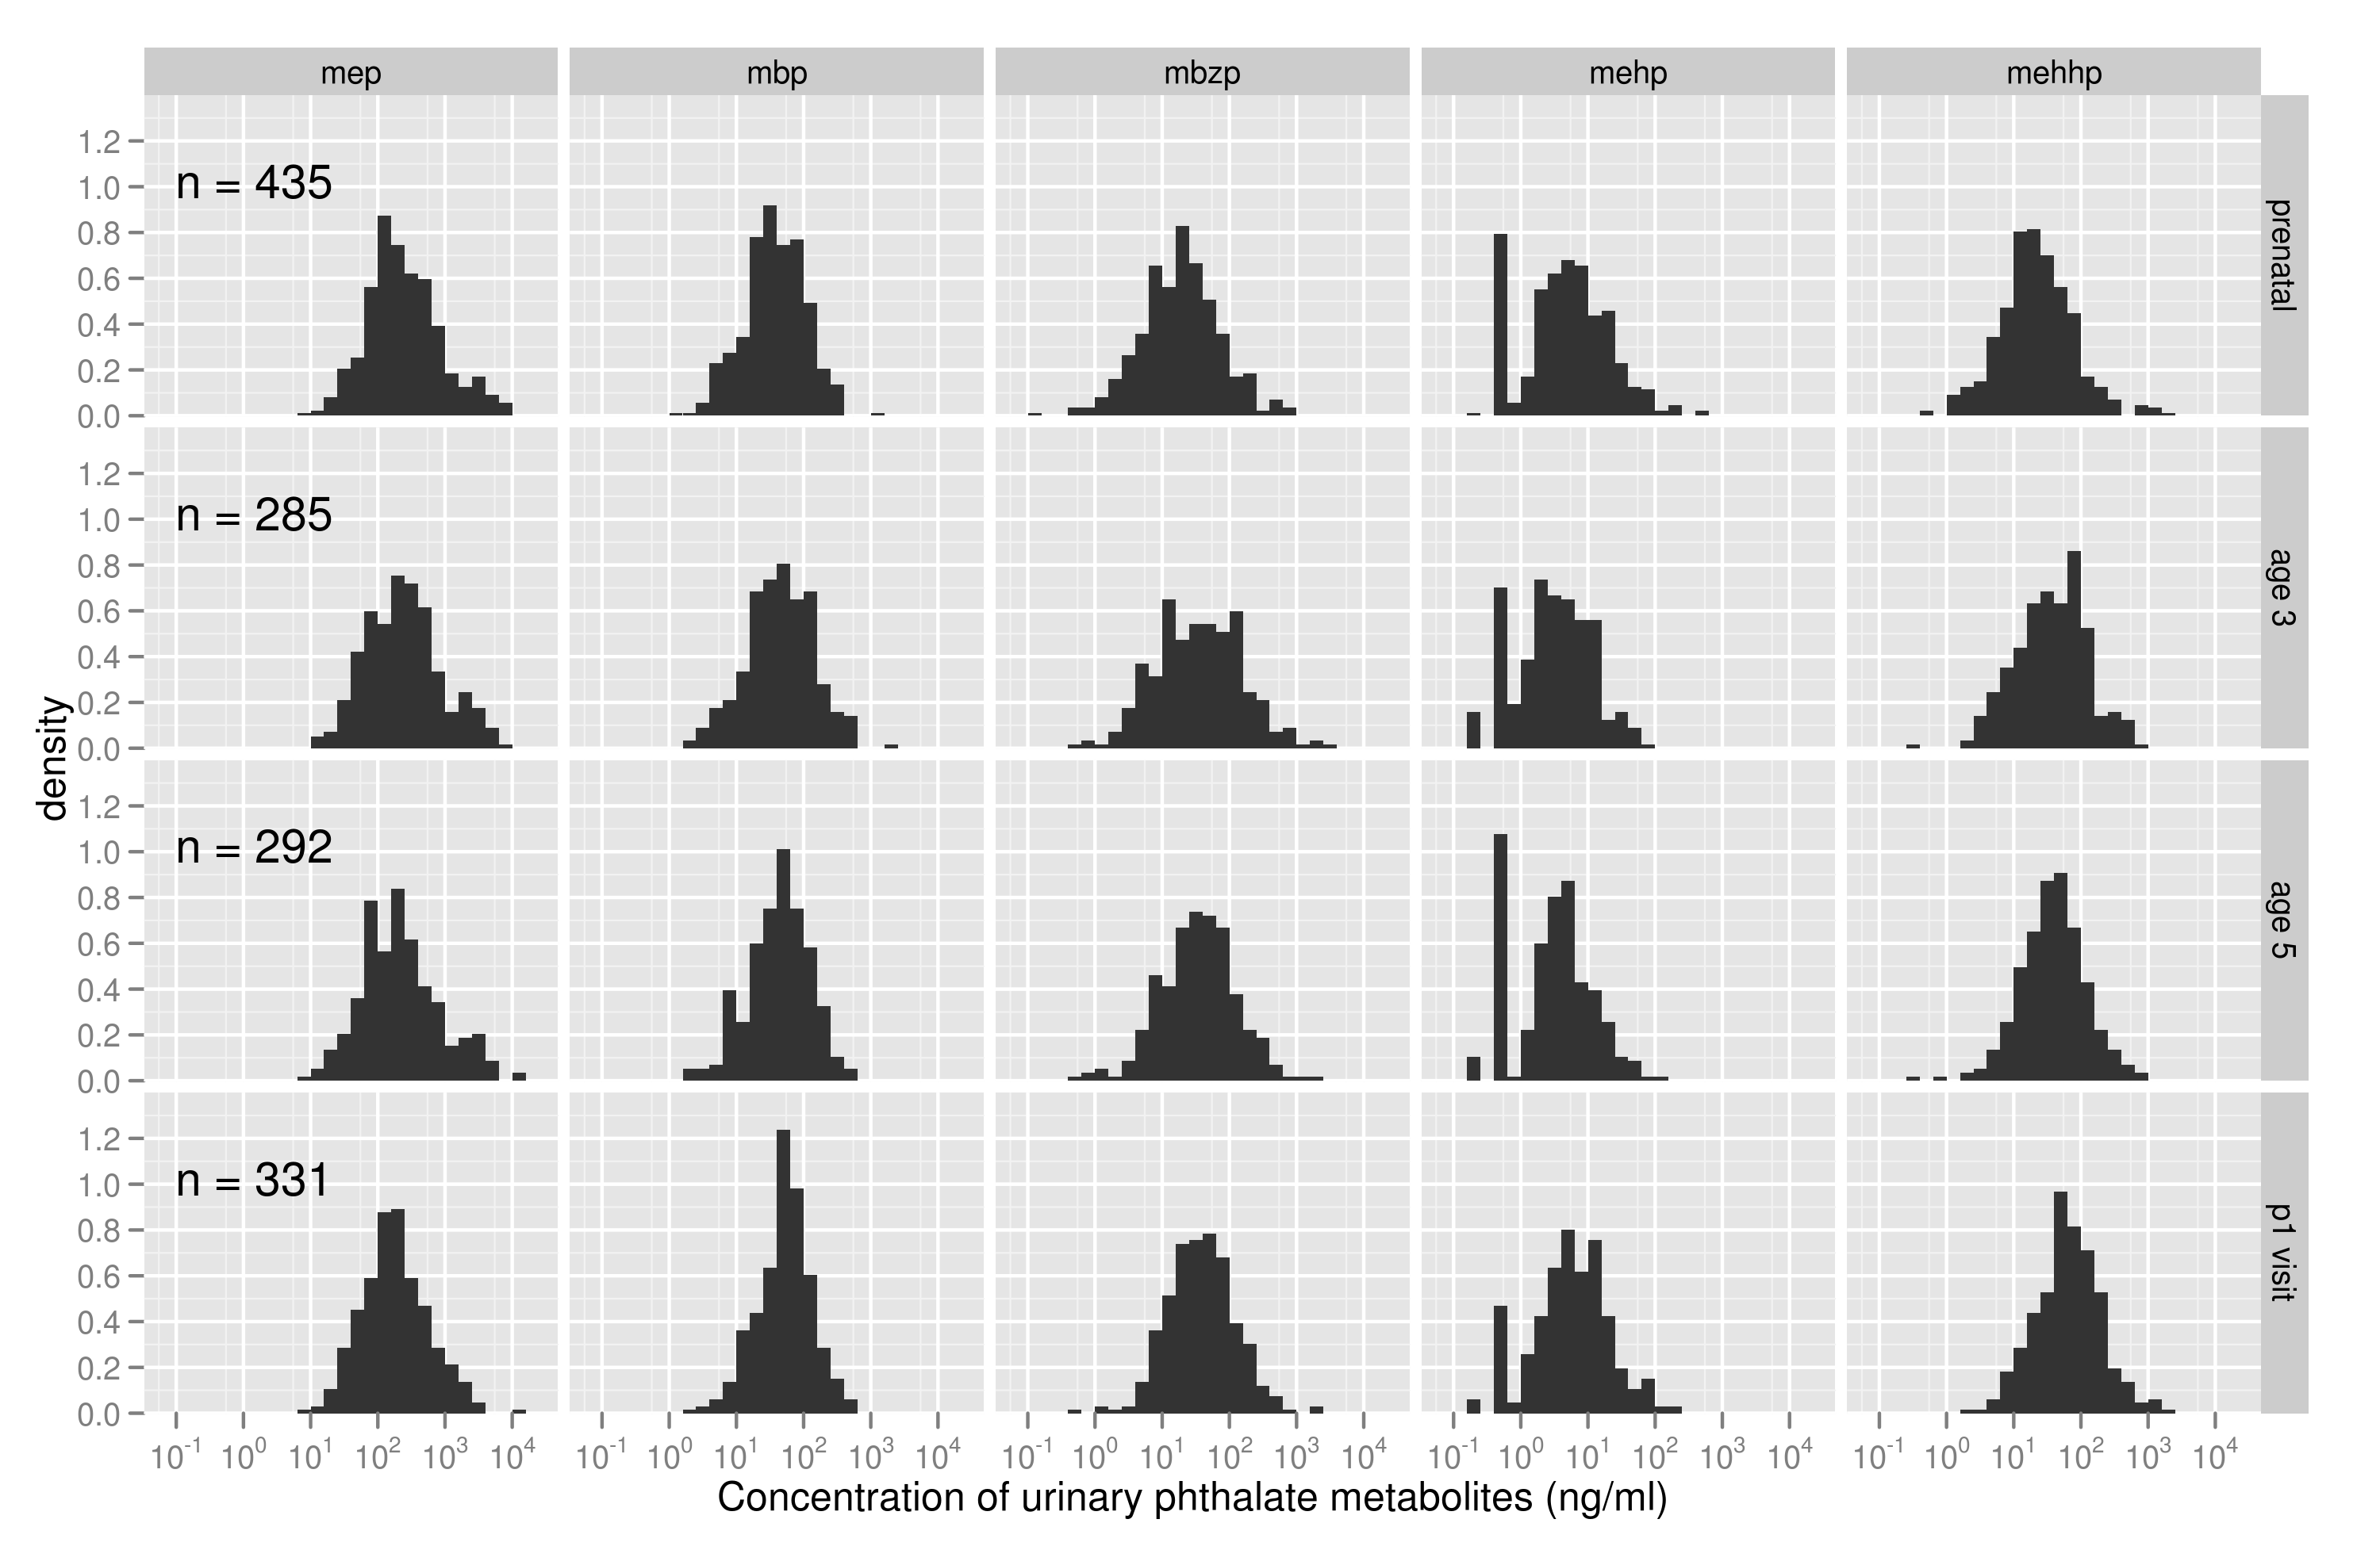
Small multiples (show many subsets)

Slide 45
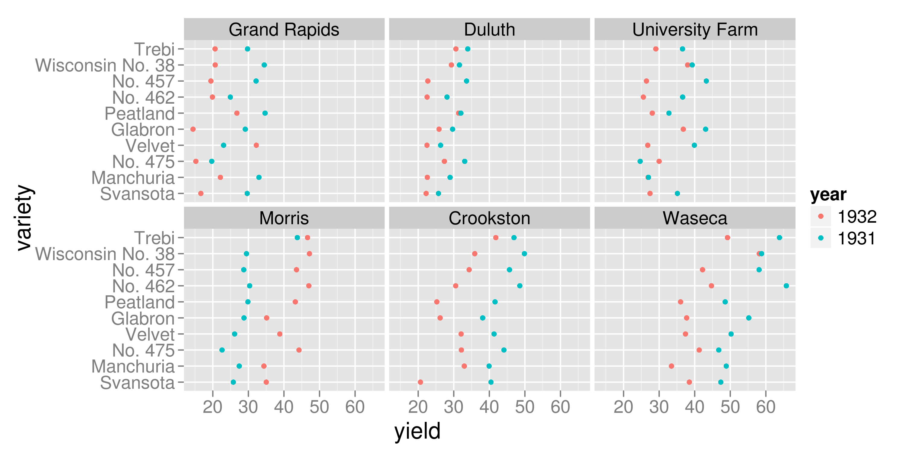
Why compare results across data subsets?
Cleveland’s analysis from the Barley dataset
Notes:
http://4dpiecharts.com/2010/10/31/presenting-immers-barley-data/

Slide 46
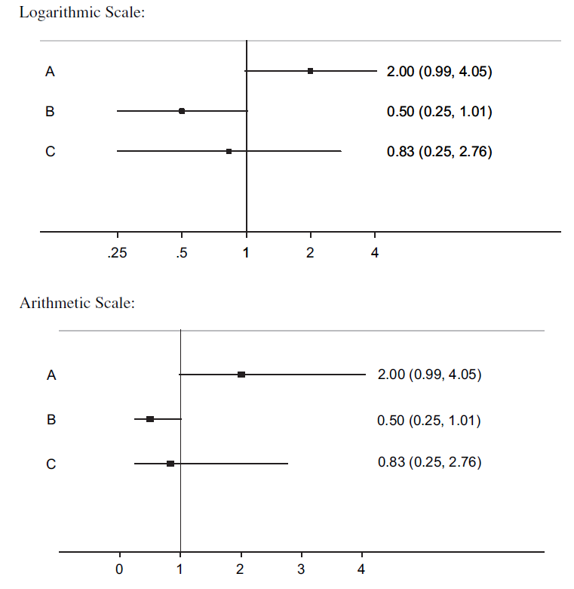
Picking scales: when to use a log scale
Levine et al. J Clin Epi. 2010
Notes:
In a review of articles from 2007-2008, 50% of articles plotting ratio measures in The Lancet and The New England Journal of Medicine got this wrong

Slide 47
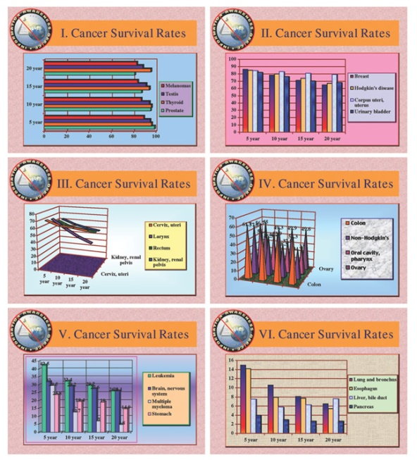
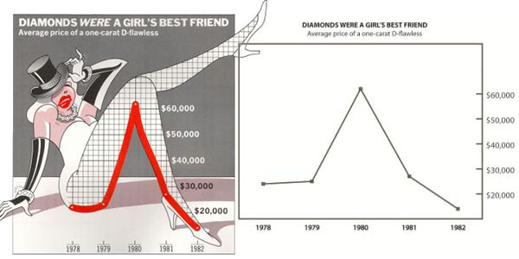
Avoid distraction
forgo "Chartjunk"
– Edward Tufte
Maximize the data/ink ratio

Slide 48
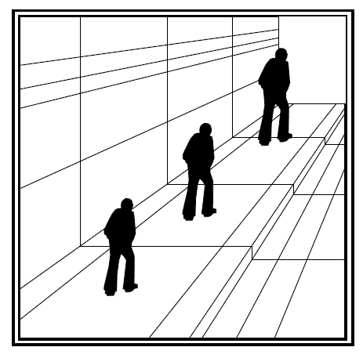
Avoid unnecessary dimensions
Remember - we use depth cues to estimate real world dimensions
stat.auckland.ac.nz/~ihaka/120/

Slide 49
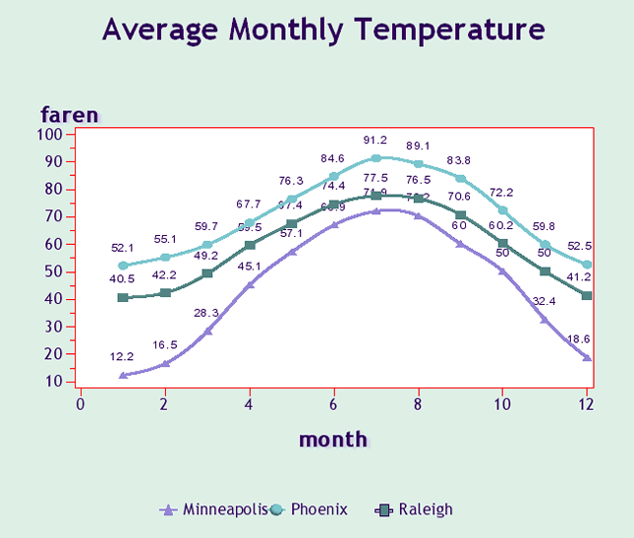
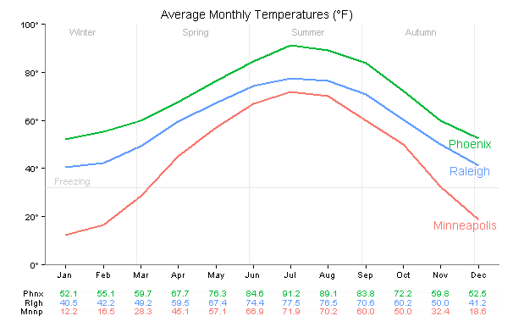
Legend
Make it easy to lookup values – match the order on graph
Label your data directly when you can
geom_text()
directlabels is a package that does wonders with ggplot2
learnr.wordpress.com
Made in SAS
Redone in R

Slide 50
Explain your story in words as well
"A picture plus 1000 words is better than two pictures or 2000 words"
-Andrew Gelman

Slide 51
Recap: Designing a good scientific figure
Answer a question – usually a comparison
Use an appropriate design (emphasize comparisons of position before length, angle, area or color)
Make it self-sufficient (annotation & figure legend)
Show your data – tell its story

Slide 52
Questions?

